Slide 1
Loops

Slide 2
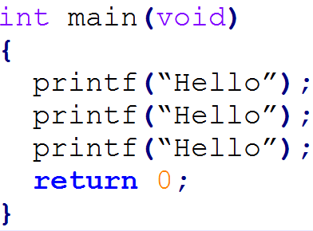
Do it again and again and again…
Sometimes we want to repeat something

Slide 3
Can We Do Better?
Easy for a few repetitions
What about 10? 20? 100? 1,000,000?
Enter Loops!
Loops repeat code as much as we want

Slide 4

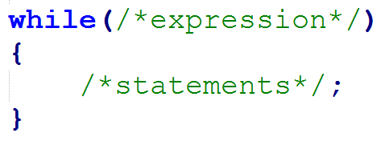
while Loop
while expression is true, execute the statements
Stops when expression is false

Slide 5
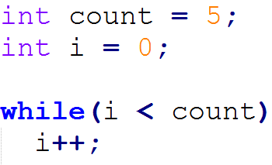
Simple while example

Slide 6
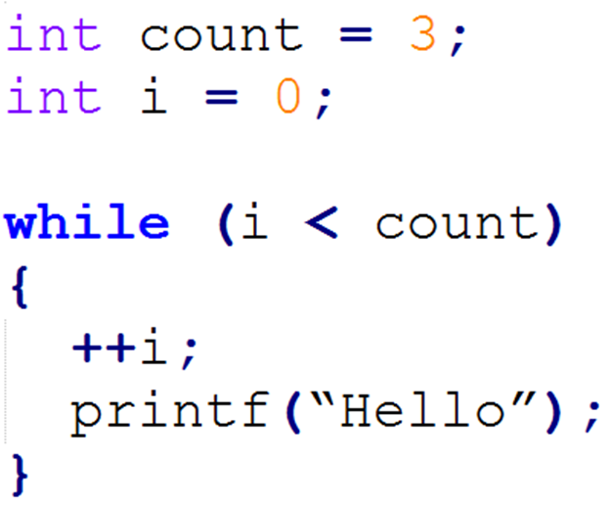
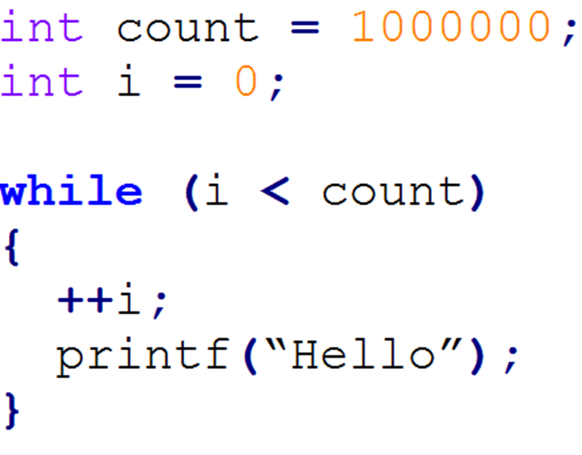
while Examples

Slide 7
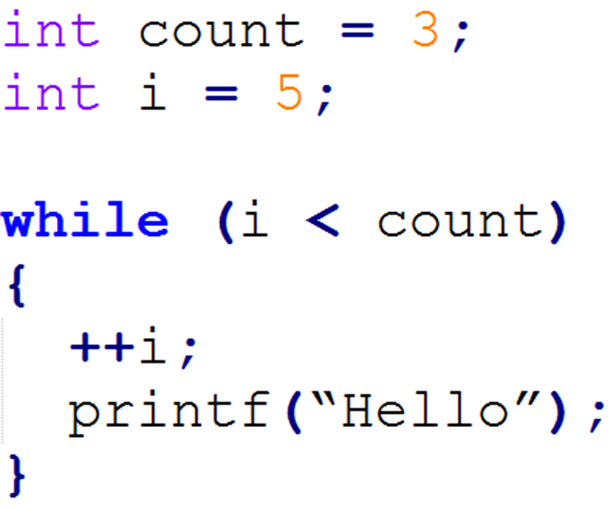
A Loop That Doesn't Loop
The expression is false at start
The loop never starts and the code never runs

Slide 8
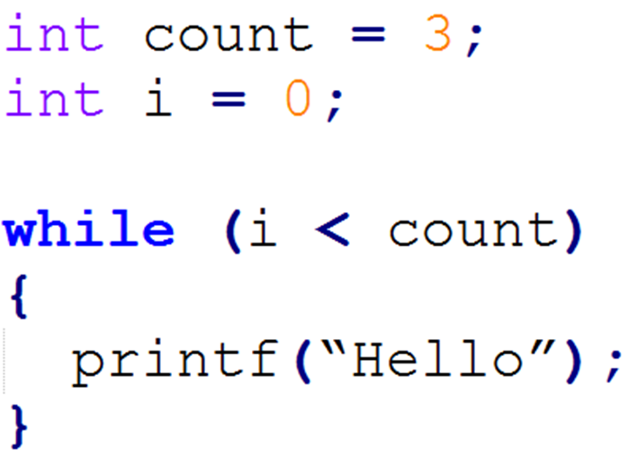
A Loop That Never Ends
expression is always true
Infinite loop – our program will hang forever

Slide 9
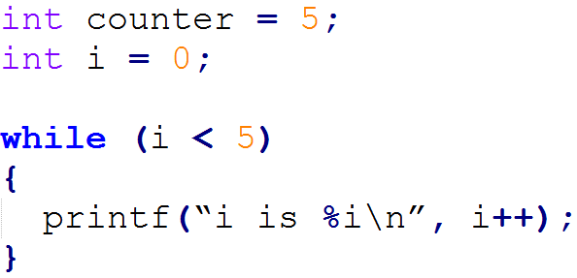
Self Check
What's the output of this code?

Slide 10
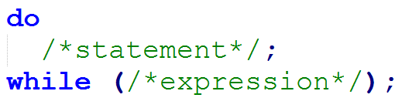
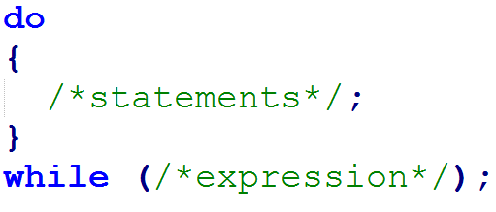
do while Loop
Checks expression at the end
Always executes statements at least once

Slide 11
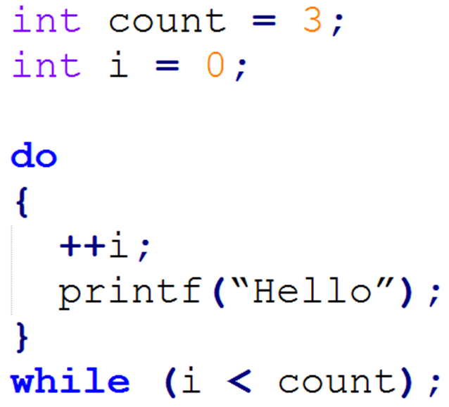
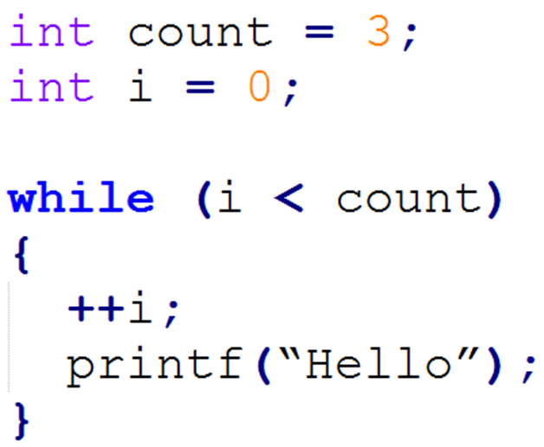
Simple Example (same output)

Slide 12
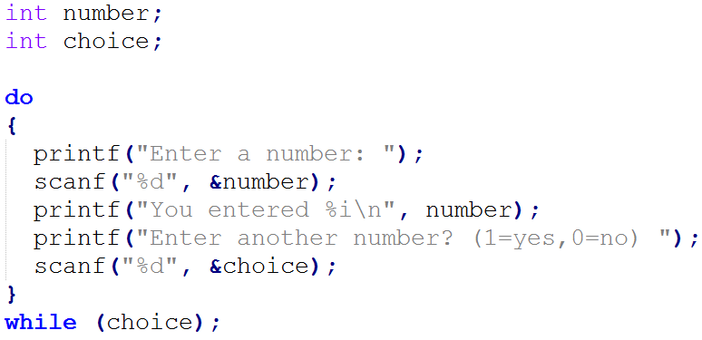
Practical Example

Slide 13
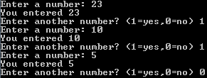
Practical Example Output

Slide 14
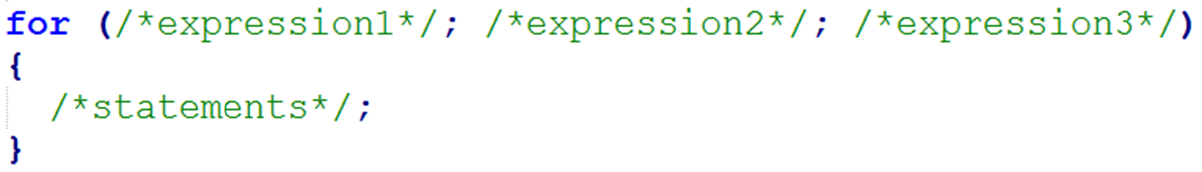
for Loop
All the while loops had the same three things:
A variable for counting: i = 0;
A check to continue the loop: i < count;
Update the counting variable: ++i;
for loop combines these into a single line

Slide 15
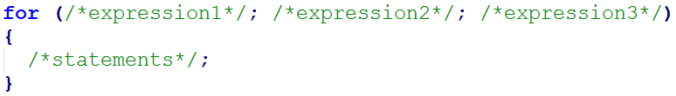
How do you read that?
Evaluate expression1, do this once at the beginning of the loop
If expression2 is true, execute statement. If false, end the loop
Evaluate expression3
Go to step 2; repeat

Slide 16
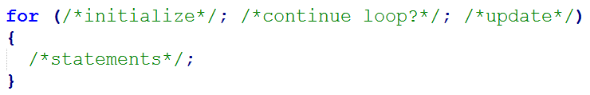
Another Way To Think About It
Initialize counter variable
Check to see if loop should continue
Update counter variable
Go to step 2

Slide 17
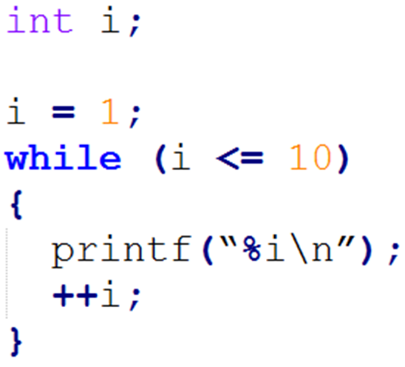
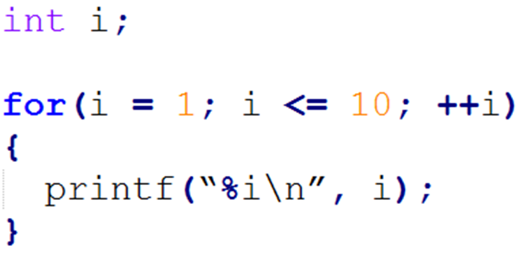
Simple Example

Slide 18
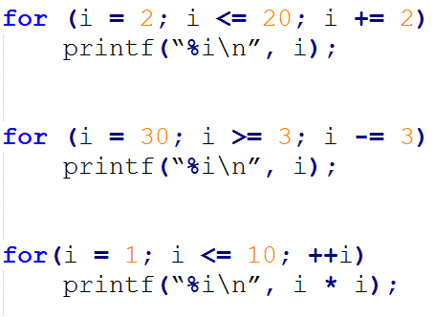
More Examples
Count to 20 by 2s
Count down from 30 by 3s
Squares of 1 to 10

Slide 19
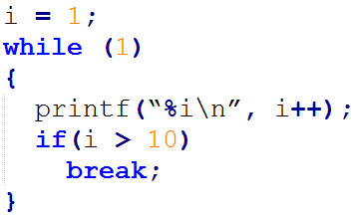
break statement
Used to stop a loop prematurely
Using break to end an infinite loop:

Slide 20
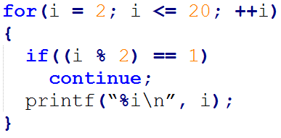
continue statement
Stops executing code and goes back to the beginning of the loop
Keeps looping afterwards

Slide 21
Summary
Loops are used to do thing repetitively
while loops execute it’s statements as long as the expression is true
do while’s execute at least once
while checks at the top of the loop, do while checks at the end
a for loop is a more succinct version of a while loop

Slide 22
Questions?

